Slide 1


Presented By:
Nurul Alam – 223002073
Course: Operating Systems Lab
Course Code: CSE 310
Section: 223 D1
Presented To:
Md. Solaiman Mia
Assistant Professor and Deputy Director of Student Affairs
Department of CSE
Green University of Bangladesh

Slide 2

Title: Vehicle Service Center Management System
Subtitle: A Bash Shell Script Project
PROJECT NAME

Slide 3
INTRODUCTION
Vehicle service management is a real-world problem.
Manual record-keeping is time-consuming & error-prone
This project automates:
Vehicle registration
Service record management
Delivery status tracking
User and Admin panels

Slide 4

To provide a simple and automated solution for managing vehicle service centers.
Implement login system for users and admins.
Maintain secure user-specific storage.
Track vehicle service status (delivered / not delivered).
Provide admin control over user data.
OBJECTIVES

Slide 5

User Panel:
  Vehicle Registration
  Add Service Records
  Update Delivery Status
  View Delivered / Not Delivered / All Records
  Delete or Clear Records
KEY FEATURES
Admin Panel:
  View All Users
  Delete User Account
  Access User Records

Slide 6

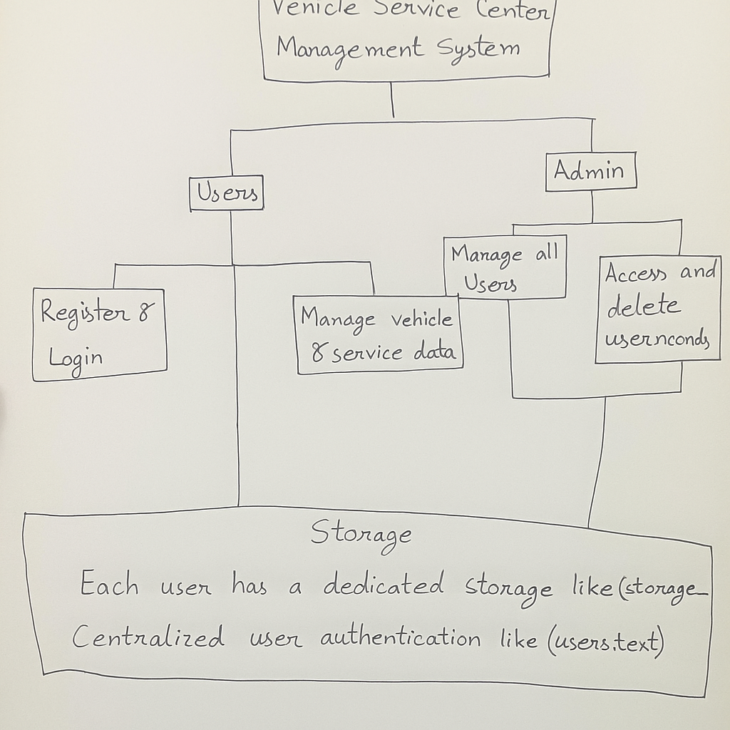
SYSTEM ARCHITECTURE

Slide 7

Language: Bash Shell Script
Platform: Linux ( Kali)
Tools:
  awk, sed, grep for text processing
  column for tabular output formatting
  Linux file system for data storage
TECHNOLOGY USED

Slide 8

IMPLEMENTATION WORKFLOW
User registers and logs in.
Vehicle details added & stored in text file.
Services and charges recorded.
Delivery status updated.
Records can be viewed, deleted, or cleared.
Admin monitors and manages all users

Slide 9
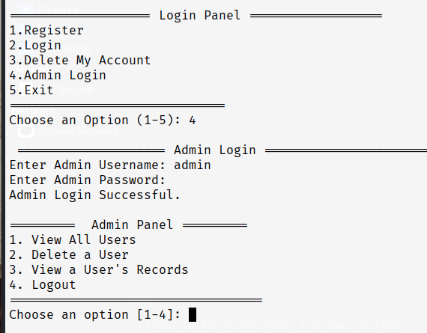
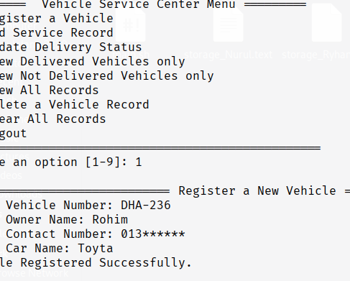
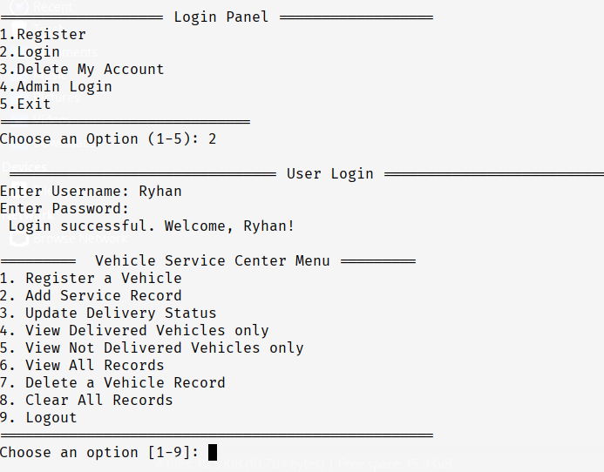
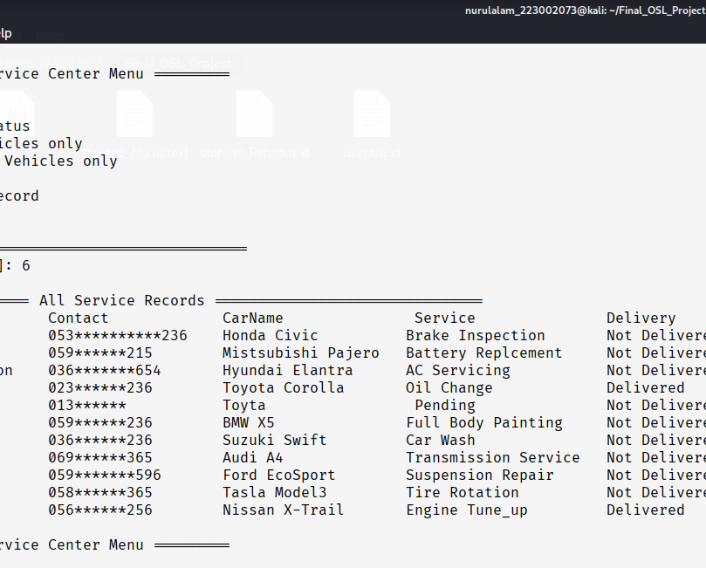
SAMPLE OUTPUTS

Slide 10
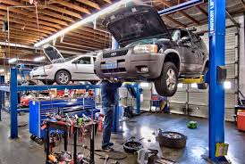
ADVANTAGES
Easy to use CLI-based system.
Ensures simple data security per user.
Lightweight & requires no external database.
Provides separation of user and admin roles.

Slide 11

LIMITATIONS
Text-based storage .
No encryption in password storage.
Limited to Linux environments.
Requires manual backup of files.

Slide 12





FUTURE ENHANCEMENTS
Add GUI interface using Zenity/Tkinter.
Integrate database (MySQL / SQLite).
Implement password hashing for security.
Add report generation (PDF/Excel).
Real-time SMS/Email notification system.

Slide 13

CONCLUSION
The project demonstrates how Shell scripting can solve real-world problems. Provides a functional vehicle service center system. Covers user authentication, CRUD operations, and admin control. A foundation for future enhancements towards a complete management software.

Slide 14

Q/A
Any questions?

Slide 15

THANK YOU FOR LISTENING

